Slide 1
Git Merge on the Git Bash Console

Slide 2
What is Git Merge?
The Git Merge is a very essential feature you need to have knowledge about because it works hand in hand with the Git Branch feature.
As the name suggests, the Git Merge basically combines/merges any two branch together. I will use some visuals to depict the Git Merge process.

Slide 3
The Git Merge Process (Diagrams)
Master
A
C1
C2
C3
C4
C5
B
Suppose we have the following commits and we created two branches off from master, A & B. In this scenario, the master branch is pointing towards Commit 3, A branch is pointing towards Commit 5 and B branch is pointing towards Commit 4. We assume that in this case that we are currently on the Master Branch. Lets create this scenario in our Git Bash console.

Slide 4
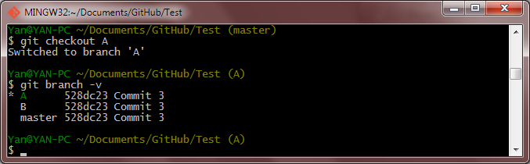
Git Merge Process (Git Bash Console)
In this screenshot of the Git Bash console, I have checked out into branch A, which means the current branch I am in is Branch A. You can see the command <$ git branch –v> allows me to view all the latest commits of all my branches within this repo currently. You can observe that all my branches have the same latest commit at the moment.

Slide 5
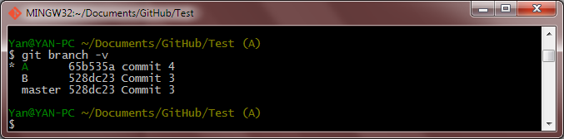
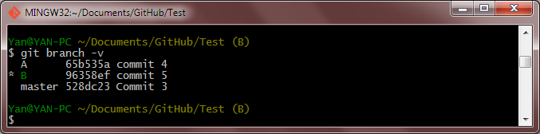
Get Merge Process (Git Bash Console)
I will make some changes in branch A and make a commit (commit 4). I will checkout to branch B and make another change and commit it as commit 5.

Slide 6
Git Merge Process
Right now we have our scenario exactly the way we want it to be. Master is pointing towards commit 3, A is pointing towards commit 4 and B pointing towards commit 5.
Master
A
C1
C2
C3
C4
C5
B

Slide 7
Fast Forward Merge (Diagrams)
Assuming we want to merge A with master, what would happen? The result would look something like this:
Master
Master
A
C1
C2
C3
C4
C5
B
Because Master is a direct ancestor of A, Git will detect that and will simply move the Master branch forward to A’s commit. Technically, this is called a Fast Forward Merging and it happens because the commit 3 in Master branch can be found in the commit history in the A branch. Thus Git will make things simple by moving master branch forward and pointing it at commit 4 which is the latest commit in A branch. Lets execute this in the Git Bash Console.

Slide 8
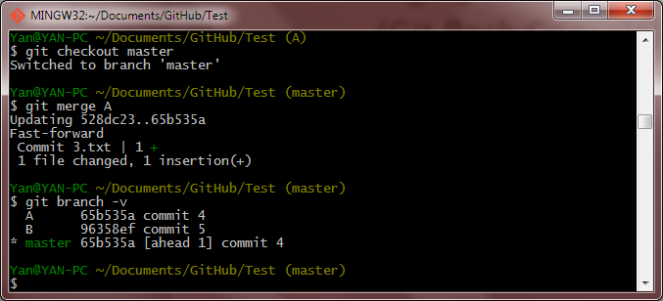
Fast Forward Merge (Git Bash Console)
I first switch to my master branch.
Then I proceed to merge A into my master branch
Now A and master are both towards the same commit
*Note: Notice that Git tells you that the merge you just did is a Fast-forward type. This type of merge is what we have gone through previously, where in this case, Git will just move the master pointer forward to commit 4 of branch A as commit 3 in master branch is the direct predecessor of commit 4.

Slide 9
Merge Conflicts (Diagrams)
Assuming now we make changes in branch B further and then proceed to merge it back with master. Anyway if you want, you can choose to delete branch A at this point. So back to the question, what would happen now in this case?
Master
C1
C2
C3
C4
C5
C6
B
Note that in this case, B branch is not a direct successor of the current master branch, therefore the merge here will not be Fast-Forward. In this scenario where B branch is diverged from some older point (Commit 3), two results will happen when you try to merge it with the current master:
A merge conflict which after resolved will also result in a new commit
A success recursive merge which will result in a new commit

Slide 10
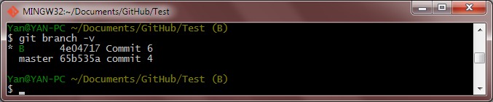
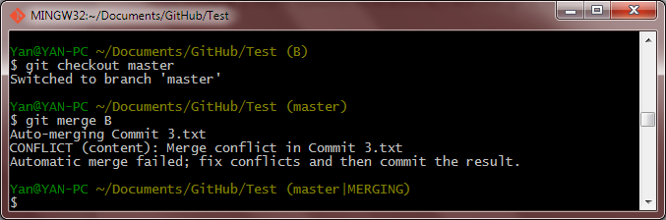
1. Merge Conflicts (Git Bash Console)
After making 1 more commit to branch B, I will merge it back with master.
I got a merge error and this is because there are different changes in the same part of the same file in both branches. But don’t worry, I just need to access the file and resolve the conflicts and recommit.

Slide 11
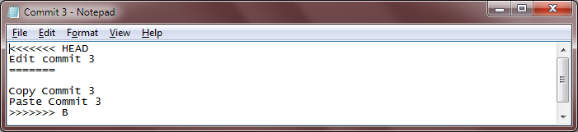
Resolving Conflicts (Git Bash Console)
This is what you should see within the text file if there is a merge conflict. I am not sure about other type of files but for source code files, Git will have marked the areas in the file where there is a conflict similar to what you are seeing in the text file below.
This is the divider, the section above represents the changes in your HEAD commit (in this case the master branch commit) while the section below represents the changes in your branch B.

Slide 12
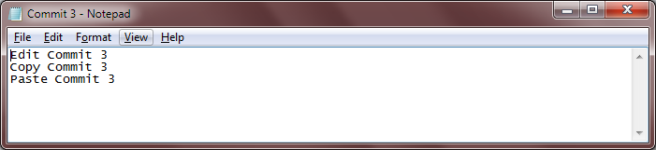
Resolving Conflicts (Git Bash Console)
To resolve the conflict, I will remove all the contents within the file and type in the contents which I want in the merged file manually. Git will detect this change as a modified file and you will need to create a new commit for this change.

Slide 13
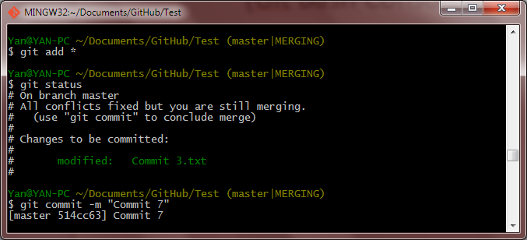
Resolving Conflicts (Git Bash Console)
Here, I stage the modified Commit 3.txt and commit the change as Commit 7.

Slide 14
Merge result after resolving conflicts
After committing the change, your repo workflow should look something like the below figure:
Master
C1
C2
C3
C4
C7
C5
C6
B

Slide 15
2. Successful Recursive Merge (Diagrams)
If there is no merge conflict, your repo workflow will still look the same:
Master
C1
C2
C3
C4
C7
C5
C6
B

Slide 16
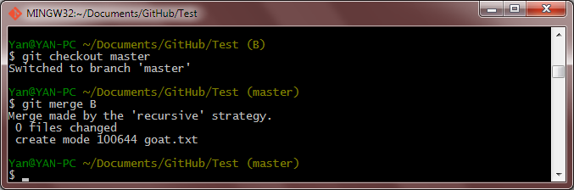
2. Successful Recursive Merge (Git Bash Console)
But what you will observe in your git bash console will be a little different. This is called a recursive merge. In this scenario, instead of changing the contents within the Commit 3.txt file which is a file existent in both B and master branch, I created a new file called goat in branch B. Therefore when I initiated the merge, all git had to do was to transfer the goat file which did not exist in master branch into the master branch.

Slide 17
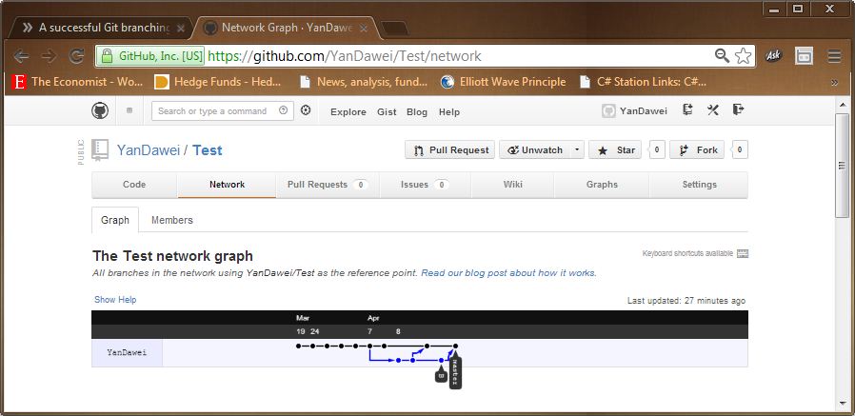
Tips
To view your repo workflow in graphical form, simply login to your github account and navigate your way to your repo’s network graph. It should look something like this:

